Slide 1
Subnetting in Networking

Slide 2
The process of dividing a single network into multiple sub networks is called as subnetting.
The sub networks so created are called as subnets.

Slide 3
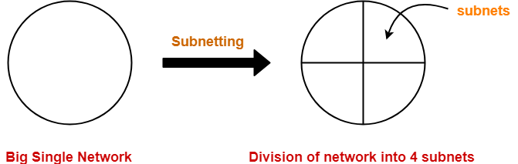
Example-
Following diagram shows the sub netting of a big single network into 4 smaller subnets-
The two main advantages of sub netting a network are-
It improves the security.
The maintenance and administration of subnets is easy.

Slide 4
Subnet ID-
Each subnet has its unique network address known as its Subnet ID.
The subnet ID is created by borrowing some bits from the Host ID part of the IP Address.
The number of bits borrowed depends on the number of subnets created.

Slide 5
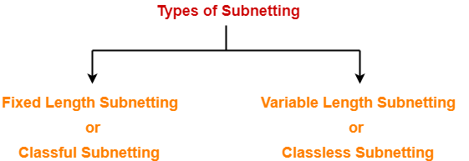
Types of Sub netting-
Sub netting of a network may be carried out in the following two ways-

Slide 6
1. Fixed Length Subnetting-
Fixed length sub netting also called as classful sub netting divides the network into subnets where-
All the subnets are of same size.
All the subnets have equal number of hosts.
All the subnets have same subnet mask.
2. Variable Length Subnetting-
Variable length sub netting also called as classless sub netting divides the network into subnets where-
All the subnets are not of same size.
All the subnets do not have equal number of hosts.
All the subnets do not have same subnet mask.

Slide 7
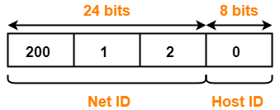
Example-01:
Consider-
We have a big single network having IP Address 200.1.2.0.
We want to do subnetting and divide this network into 2 subnets.
Clearly, the given network belongs to class C.

Slide 8
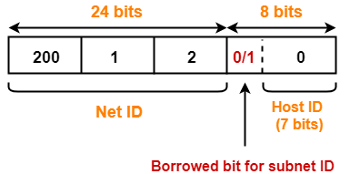
For creating two subnets and to represent their subnet IDs, we require 1 bit.
So,
We borrow one bit from the Host ID part.
After borrowing one bit, Host ID part remains with only 7 bits.

Slide 9
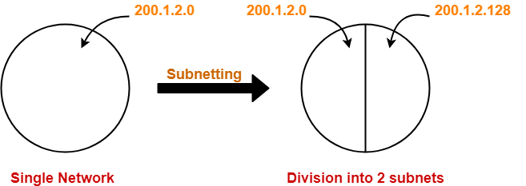
If borrowed bit = 0, then it represents the first subnet.
If borrowed bit = 1, then it represents the second subnet.
IP Address of the two subnets are-
200.1.2.00000000 = 200.1.2.0
200.1.2.10000000 = 200.1.2.128

Slide 10
For 1st Subnet-
IP Address of the subnet = 200.1.2.0
Total number of IP Addresses = 2⁷ = 128
Total number of hosts that can be configured = 128 – 2 = 126
Range of IP Addresses = [200.1.2.00000000, 200.1.2.01111111] = [200.1.2.0, 200.1.2.127]
Direct Broadcast Address = 200.1.2.01111111 = 200.1.2.127
Limited Broadcast Address = 255.255.255.255
For 2nd Subnet-
IP Address of the subnet = 200.1.2.128
Total number of IP Addresses = 2⁷ = 128
Total number of hosts that can be configured = 128 – 2 = 126
Range of IP Addresses = [200.1.2.10000000, 200.1.2.11111111] = [200.1.2.128, 200.1.2.255]
Direct Broadcast Address = 200.1.2.11111111 = 200.1.2.255
Limited Broadcast Address = 255.255.255.255

